Slide 1


Slide 2
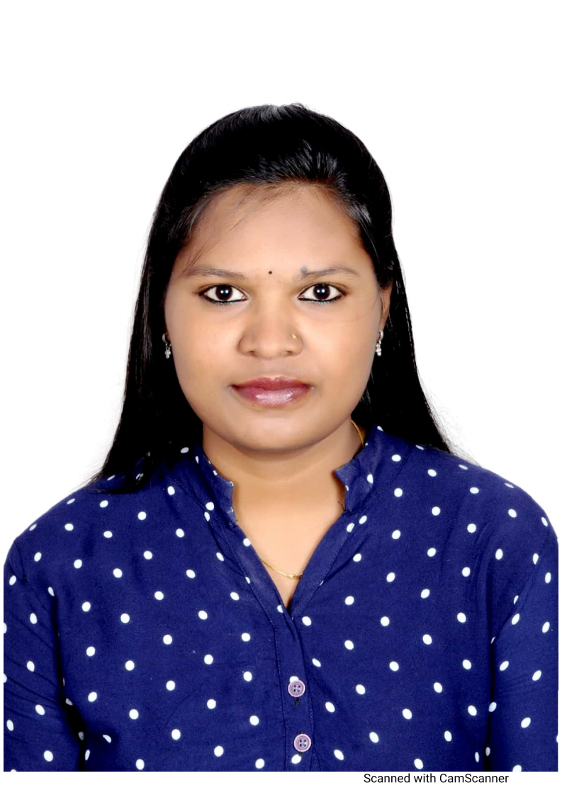
Project Highlights
Project Name : Doctor Appointment System
Team Size : 1
BU Mentor Name : Jagdish Prasad Sahu Mentor PS#20008728
Team Members Details
Asha N
PS#99002646
2009BLRMED01
B.E(Computer Science and Engineering)

Slide 3

Project Video Snippet

Slide 4
Future development that can be implemented further
Collecting the symptoms of patient, then providing the prescription
Implement using Large data set
GitHup repository link:
https://github.com/99002646/MiniProject_Cpp.git

Slide 5


Thank You !

